Slide 1
Introduction to ArcGIS and Opensource GIS
February 10 – 14
Disciplinary Course
ZEFc
Valerie Graw
Lisa Freudenberger
Antonio Rogmann
Max Stephan

Slide 2










Popular Open Source Software
Firefox – Internet Browser
Open Office – Office software package
Linux – operating system
7Zip – file archiver software
GIMP – raster graphics editor
Inkscape – vector graphics editor
Blender – 3D Object Software
Miranda – Chat Software
Filezilla – FTP Program
VLC – Media Player

Slide 3

Open Source Software
Open Source - Definition
Open source definition of the Open Source Initiative:
1. Free Redistribution
2. Redistribution of Source Code
3. Derived Works
4. Integrity of The Author's Source Code
5. No Discrimination Against Persons or Groups
Notes:
4. : The license may restrict source-code from being distributed in modified form only if the license allows the distribution of "patch files" with the source code for the purpose of modifying the program at build time. The license must explicitly permit distribution of software built from modified source code. The license may require derived works to carry a different name or version number from the original software.

Slide 4
Open Source Software
Open Source - Definition
Open source definition of the Open Source Initiative :
6. No Discrimination Against Fields of Endeavor
7. Distribution of License
8. License Must Not Be Specific to a Product
9. License Must Not Restrict Other Software
10. License Must Be Technology-Neutral
www.opensource.org

Slide 5
What is the difference between open and free?
Is a software without a fee always open source?
NO - software can be free but the source code can be closed.
Is open source software always without any fee?
YES and NO: Redistribution of software is possible without a fee (no copy protection etc.)
BUT a fee can be charged for the possibility to obtain the software e.g. the possibility to download it or the cd that contains it (copyleft-style OS license)
Does free software mean without any fee?
According to the Free Software Foundation NO
The Free Software movement and the Open Source movement are like two political camps within the free software community.
“Free software” is a matter of liberty, not price. To understand the concept, you should think of “free” as in “free speech,” not as in “free beer”.
Free Software is not necessarily Freeware!

Slide 6

Free Software - Definition
A program is free software if the program's users have the four essential freedoms:
The freedom to run the program, for any purpose (freedom 0).
The freedom to study how the program works, and change it so it does your computing as you wish (freedom 1). Access to the source code is a precondition for this.
The freedom to redistribute copies so you can help your neighbor (freedom 2).
The freedom to distribute copies of your modified versions to others (freedom 3). By doing this you can give the whole community a chance to benefit from your changes. Access to the source code is a precondition for this.
www.gnu.org

Slide 7
Pros of OSS
Reduced costs – often no fee at all
No License restrictions – software can be copied as many times as necessary
Quality Control and Transparency – code can be reviewed and errors can be reported
Localization – software can be adapted to specific needs
Support – many different support options often exist in forums and mailing lists but also support from developers
Quality – many users argue that OSS quality is higher due to quality control and transparency
Evolution – often adapts faster to the needs of users than proprietary software
Evaluation - evaluation is easier because you can just install it and see if you like it

Slide 8
Cons
No or less personal support – depends very much on the software
Lack of training – often proprietary software is taught in class
Maintenance – it requires a huge effort to maintain a OSS

Slide 9


Open Source and GIS
A large number of different OSS and proprietary GIS applications is available.
Many of these use GDAL as a basis
a translator library for raster geospatial data formats
distributed under an X/MIT style Open Source license
released by the Open Source Geospatial Foundation
a large number of supported formats (~30 read and write, much more read only)
variety of useful command line utilities for data translation and processing
ArcGIS, Google Earth, GRASS GIS, gvSIG, QGIS, R, SAGA GIS, OpenEV, Insensa GIS

Slide 10
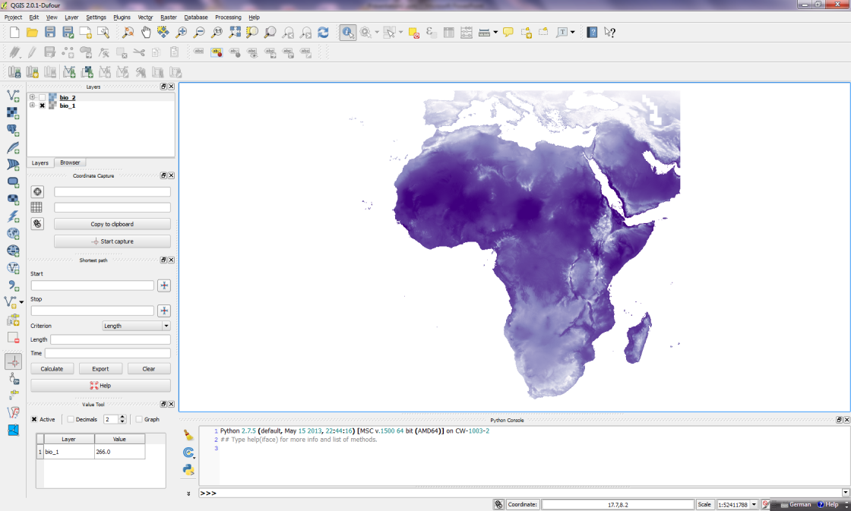

QGIS
QGIS - Quantum GIS
Desktop application with easy GUI for Windows, MacOS, Linux and Android
Strength in map display, weakness in statistical analysis
BUT: User interface also for GRASS and other tools
Large number of plugins (number is increasing)
Python Console available

Slide 11

GRASS
GRASS – Geographic Resources Analysis Support System
Official project of OSGeo
Originally written for Unix by US Army
Very powerful software with a huge support community
Originally command based but now available with GUI and command section as well as python shell
Utilization of R functions is possible

Slide 12
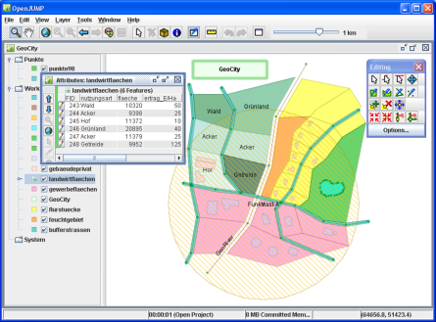
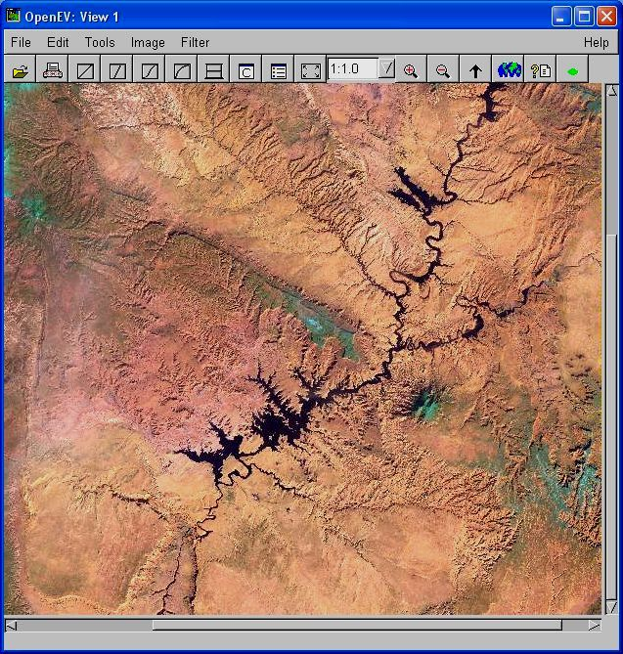
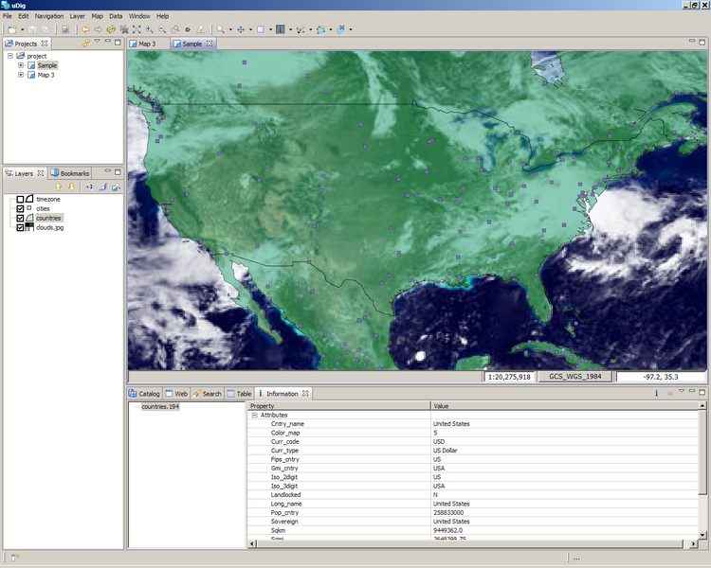
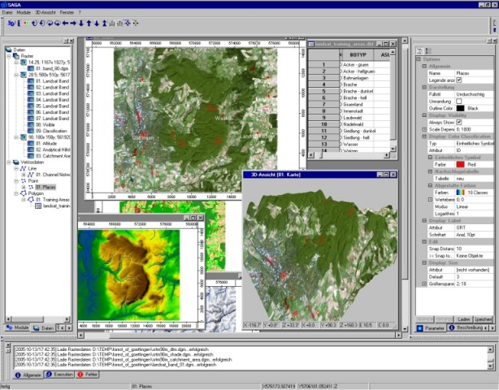
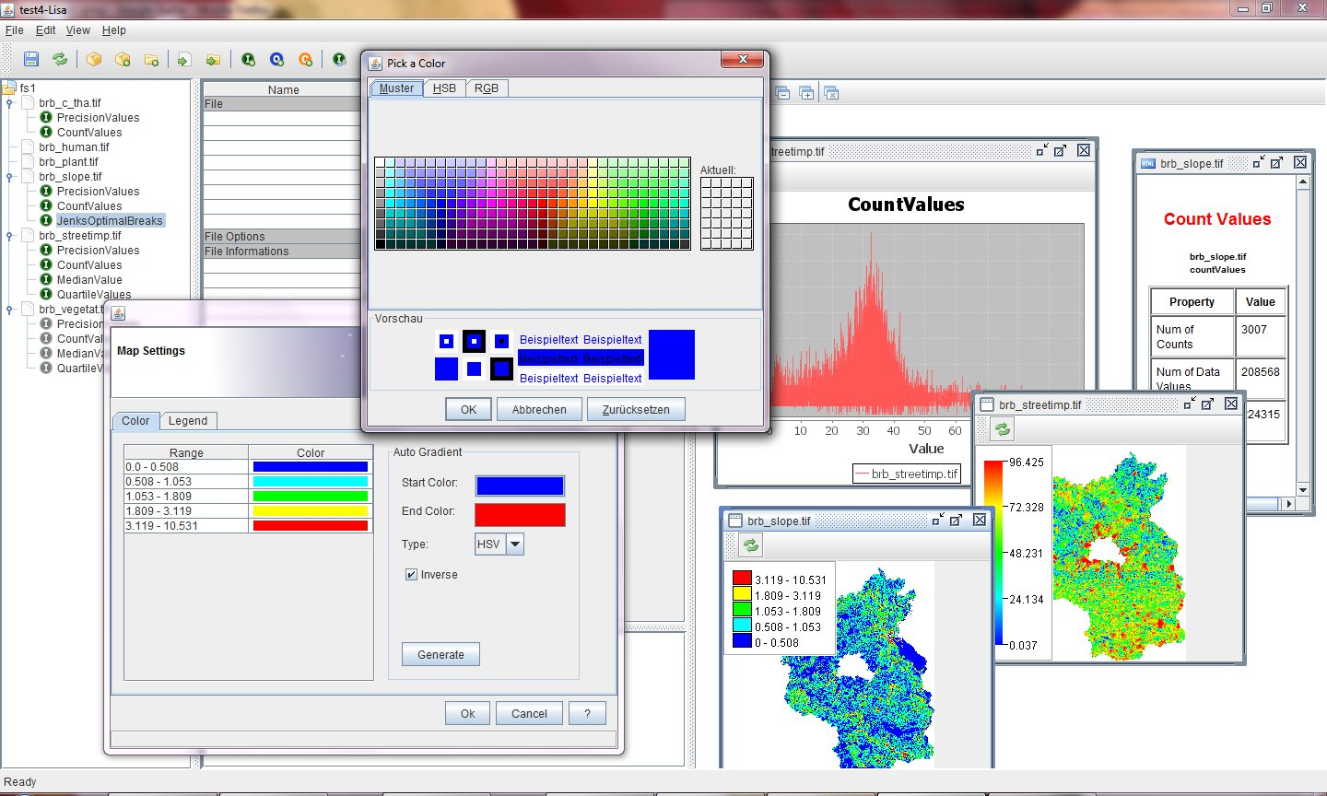
Other OSS desktop GIS software
OpenJump (written in Java, vector based)
OpenEV (written in Phython, mainly to display and edit maps)
uDig (written in Java, based on Eclipse Platform)
Saga GIS (written in C++, using GDAL)
Insensa GIS (written in Java, using GDAL)
Many more….

Slide 13
Insensa GIS
Insensa GIS (Index and Sensitivity Analysis GIS)
Raster based (shapes can be rasterized)
Possibility to visualize maps, diagrams and tables
Functions are categorized into
Information Reader
Option File Changer
Connection
Information
e.g. statistic

Slide 14
Index Development
Create one index out of many indicators, e.g. an index for landuse intensity
Steps:
Import necessary files
Normalize all indicators
Combine them in one index with indicator weighting
Calculate the correlations
Visualize the index
Perform a sensitivity analysis
Visualize the coefficient of variation
Visualize the volatility

Slide 15

R
Programming language and software environment for statistical computations
High number of “packages” to perform different calculations, to analyze and display data
Different user interfaces
Also various GIS functions available
BUT first…. Let´s see how R works

Slide 16
R Introduction
Topic | Code | Description
Simple Calculations | > 2+3 [1] 5 | “>….” is a command line, “[1]5” is the output
Variables | > a=2+3 > a [1] 5 | Assign 2+3 to “a” You may use a “<-” instead of a “=“
 | >ls() >rm(list=ls()) | List all your variables Remove all your variables
Vectors | > b=c(2,3,4) > b [1] 2 3 4 | Create a vector with the function “c” that combines arguments into a vector or a list
Functions | > c=sum(b) > c [1] 9 | Functions have been implemented to make your life easier e.g. to sum the values of a vector
 | > sum function (..., na.rm = FALSE) .Primitive("sum") | Type in only the function name to see the “head” of the function

Slide 17
R Task 1
Create a vector with the length of 10 and the numbers 2,4,6,8,10,12,14,16,18,20
Calculate the sum of all values within the vector

Slide 18
R Introduction
Topic | Code | Description
Download, install and load packages into R | >install.packages(“raster”) > library (raster) | Functions are combined in so-called “packages” “library“ and “require” can both be used to load the package
Working directory | > setwd("C:/Users/….") > getwd() [1] "C:/Users/….“ >list.files() | Get and set the working directory The working directory is the Default location for import and export List the files of your working directory
Get Help | >?sum >help(sum) >??sum | Use “??” if you have not loaded the package with the function. In some GUIs it is also possible to get help in the console by hitting TAB (in R-Studio)

Slide 19
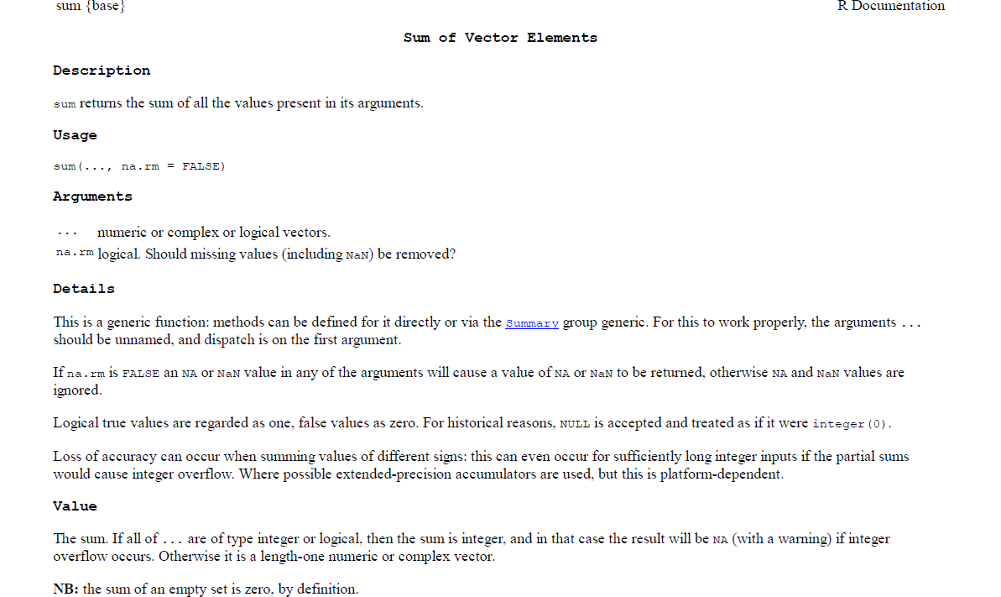
How does the help of R look like?
Function{Package}
Function(Arguments)
Output

Slide 20
R Introduction
Topic | Code | Description
Vectors - Creation | > v1 = c(1,2,3,4,5) > v1 [1] 1 2 3 4 5 | Create a vector with “c”
Vectors - Indexing | > v1[2] [1] 2 > v1[2]=4 > v1 [1] 1 4 3 4 5 | Call the second value of the vector Replace the second value
Vectors – Automated Creation | > v2=seq(from=1 , to=2, length=5) > v2 [1] 1.00 1.25 1.50 1.75 2.00 | Create a vector with 5 values ranging between 1 and 2 (equal steps)
Vectors - Operations | > v3=v1+v2 > v3 [1] 2.00 5.25 4.50 5.75 7.00 | Sum the values of vector 1 and vector 2

Slide 21
R Task 2
Create a vector with the length 50 and numbers between 0 and 5
Create a second vector with the length 50 and numbers between 100 and 150
Subtract the first vector from the second vector.
What is the 23rd value of the resulting vector?

Slide 22
R Introduction
Topic | Code | Description
Matrix - Creation | >v4=c(1,2,3,4,5,6,7,8,9,10) >mat1=matrix(data=v4,ncol=2) >mat1 [,1] [,2] [1,] 1 6 [2,] 2 7 [3,] 3 8 [4,] 4 9 [5,] 5 10 | Matrices are vectors with dimensions Define the vector first and then the matrix by giving the number of columns or rows OR
 | >mat2=matrix(data=c(1,2,3,4,5,6,7,8,9,10),nrow=2) > mat2 [,1] [,2] [,3] [,4] [,5] [1,] 1 3 5 7 9 [2,] 2 4 6 8 10 | Define the vector in the same line as defining the matrix
Matrix - Indexing | > mat2[1,2] [1] 3 > mat2[,2] [1] 3 4 > mat2[1,] [1] 1 3 5 7 9 | Call the values by giving first the number of the row and then the number of the column Return lines and columns by leaving the other field empty.

Slide 23
R Task 3
Create one matrix with 2 columns and 20 rows with the values reaching from 1 to 10 in the first column and 10 to 20 in the second column
Create a second matrix with 20 columns and 2 rows with the values reaching from 5 to 6 in the first row and 7 to 8 in the second row
Multiply the value of the first row and second column from the first matrix with the value from the 10th column and 2nd row from the second matrix.
What is the result?

Slide 24
R Introduction
Topic | Code | Description
Data Frames - Creation | > df = data.frame (A = c(“one“, “two“, “three“), B = c(4,5,6), C = c(7,8,9)) > df A B C 1 one 4 7 2 two 5 8 three 6 9 | Data frames are similar to matrices data types can be different e.g. numbers and strings With row.names=c(…) you can also add row names
Data Frames- Indexing | > df[,2] [1] 4 5 6 > df$B [1] 4 5 6 | Indexing can be done by numbers or names
Attributes | >attributes(df) | “attributes” returns a list of attributes and is helpful to understand how objects are structured

Slide 25
Task 4
Create a Dataframes with 3 columns and 4 rows. The names of the columns should be X,Y and Z and contain the values with the values 4,5,6,7 in the first, 8,9,10,11 in the second and 12,13,14, and 15 in the third column. The row names should be “yes“, “no“, “maybe“, “don´t care“.
Copy this dataframe and add a column with the sums from the values of columns x and y.

Slide 26
R and GIS
Some Packages for GIS
library(maps) - for creating geographical maps
library(mapdata) - contains basic data for ’maps’
library(rgdal) – gdal functions implemented for R
library(shapefiles) – read and write shapefiles
library(maptools) - tools for handling spatial objects
library(mapproj) - for creating projected maps
library(raster) - tools to deal with raster maps
library(ggplot2) - to create maps
library(ade4) - spatial analysis of ecological data
library(adehabitat) - ecological niche analysis
library(gpclib)- general polygon clipper
We won´t learn about all of them but get some ideas what is possible!

Slide 27
R and GIS
Topic | Code | Description
Install and load Packages | >install.packages(“maps”) >install.packages(“mapdata”) >install.packages(“raster”) >library(maps) >library(mapdata) >library(raster) | Install and load some packages that we will need
Displaying simple contour maps | >map("world","germany", fill=TRUE, col=4) >map.axes() >map("world","germany", fill=TRUE, col=4, xlim=c(6,10), ylim=c(50,51)) >map.axes() | Display a map of Germany filled with the color blue Show the map extent Zoom in to show only a specific extent
Import raster files | > list.files() [1] "bio_1.tif" "bio_2.tif" "bio_3.tif" > bio1=raster("bio_1.tif") > bio2=raster("bio_1.tif") | Use list.files() to see all your files in your working directory Create a raster object.

Slide 28
R and GIS
Topic | Code | Description
Obtain information about the raster file | > bio1 class : RasterLayer dimensions : 1969, 2082, 4099458 (nrow, ncol, ncell) resolution : 0.04166667, 0.04166667 (x, y) extent : -28.83333, 57.91667, -36.04167, 46 (xmin, xmax, ymin, ymax), coord. ref. : +proj=longlat +datum=WGS84 +no_defs +ellps=WGS84 +towgs84=0,0,0 , data source : C:\Users\lfreudenberger\....\bio_1.tif , names : bio_1 values : -118, 319 (min, max), >attributes(bio1) | Get information e.g. about resolution, extent, projection
 | > res(bio1) [1] 0.04166667 0.04166667 > extent(bio1) class : Extent , xmin : -28.83333 , xmax : 57.91667 ymin : -36.04167 , ymax : 46 | Get information only about resolution and extent
Raster statistics | >summary(bio1) >freq(bio1) >hist(bio1) > cellStats(bio1, stat="mean") [1] 220.8088 >plot(bio1, bio2) | Get some information through “summary”. Create a frequency table or a histogram of a raster map or calculate Statistical values such as sum, mean, min, max, sd…

Slide 29
R Introduction
Topic | Code | Description
Raster Algebra | >bio_tot=bio1+bio2 >bio_tot=sum(bio1,bio2) | Simple calculations can be done similar to other objects
Raster Algebra with Stacks | >s=stack(bio1, bio2,….) >s=brick(bio1, bio2,….) | It might be easier to combine files in a stack or a brick. A stack combines single raster files. stack and brick are similar but brick combines also multiband raster files
 | >bio_mean=mean(s) >bio_max=max(s) >bio_max=min(s) | Calculate the mean/max/min value over all raster files being part of the stack.

Slide 30
Task 5
Import 3 raster maps
Calculate the mean value of each of these raster maps
Combine the three raster maps in one stack
Create a new raster layer object with the maximum values in each pixel
What is the mean value of this new map?

Slide 31
R and GIS
Topic | Code | Description
Manipulate maps - Resolution | >bio1a <- aggregate(bio1, fact=10) >bio1d <- disaggregate(bio1, fact=2) >res(bio1a) >res(bio1d) | Aggregate a raster object by factor 10 or disaggregate a raster object by factor 2
Crop and extent | extent(bio1) e<-extent(10,15,12,20) bio1_sm=crop(bio1,e) bio2_sm=crop(bio2,e)
Compare and resample maps | >compare(bio1a,bio2) >bio1_resb=resample(bio1a, bio2, method=“bilinear”) >compare(bio1_resb,bio2) >bio1_resn=resample(bio1a, bio2, method=“ngb”) >compare(bio1_resn, bio2) | “Compare” checks if the resolution, extent, projection and origin between raster files match. “Resample” transfers these values between non matching raster (ngb refers to nearest neighbor, bilinear to interpolation)
Reproject maps | newproj <- "+proj=lcc +lat_1=48 +lat_2=33 +lon_0=-100 +ellps=WGS84“ pr1 <- projectRaster(bio1_sm, crs=newproj) | Get the projection from another file or define the projection yourself projInfo('proj'), projInfo('ellps'), and projInfo('datum') return lists with valid arguments if you want to define the projection independent

Slide 32
Task 6
Change the resolution of bio1 by aggregating with factor 20
Change the extent of this map to xmin=12, xmax=20, ymin=10, ymax=18
Compare the new map with bio2
Resample bio2 to fit the parameters of bio1

Slide 33
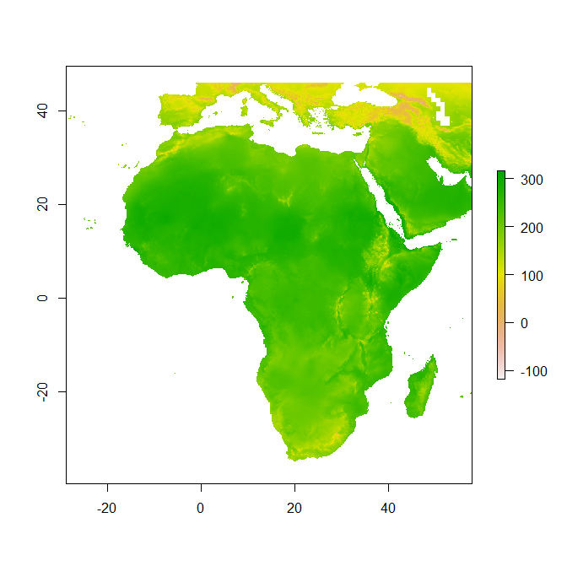
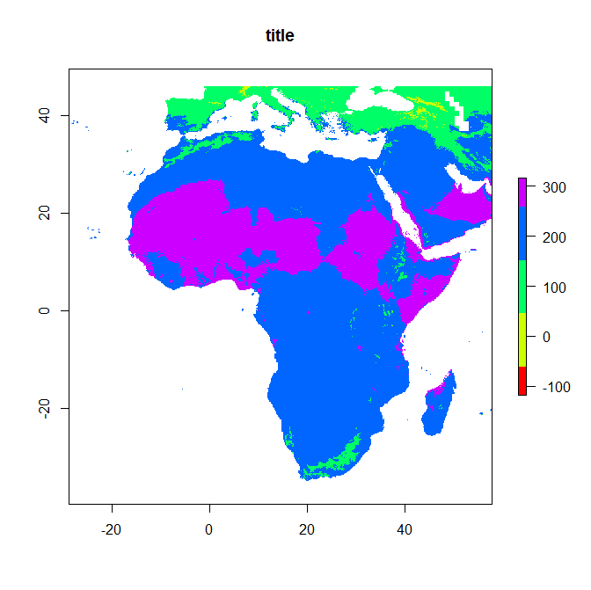
R and GIS
plot(bio1, main=“title”, col=rainbow(5))
plot(bio1)

Slide 34
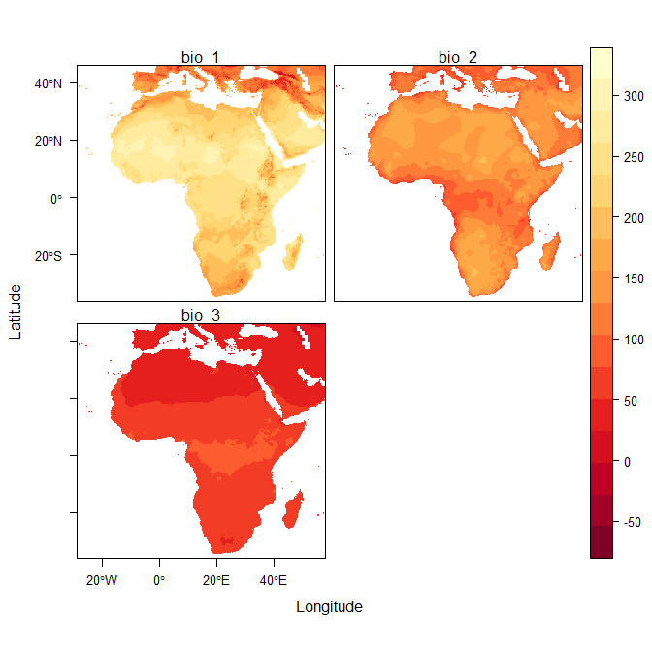
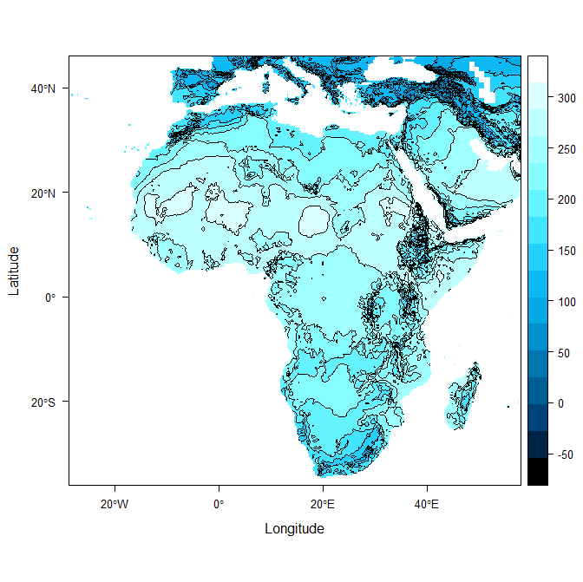
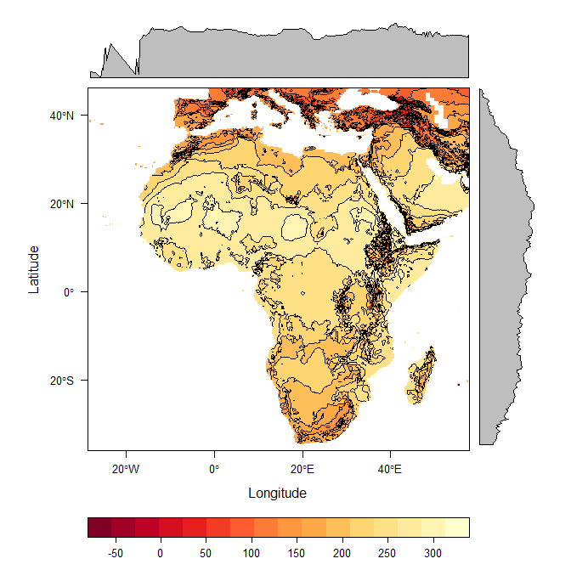
R and GIS
>levelplot(bio1)
>levelplot(bio1, contour=TRUE, FUN.margin=max)
levelplot(bio1, contour=TRUE, margin=FALSE, par.settings=BTCTheme))
install.packages(“rasterVis”)
s=stack(bio1,bio2,bio3)
levelplot(s)

Slide 35
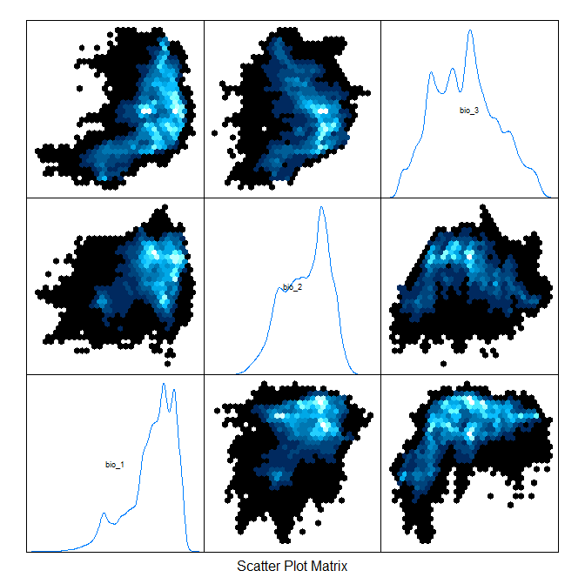
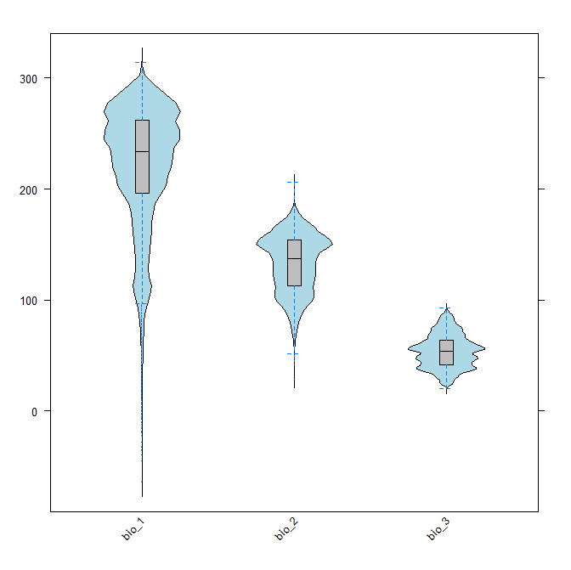
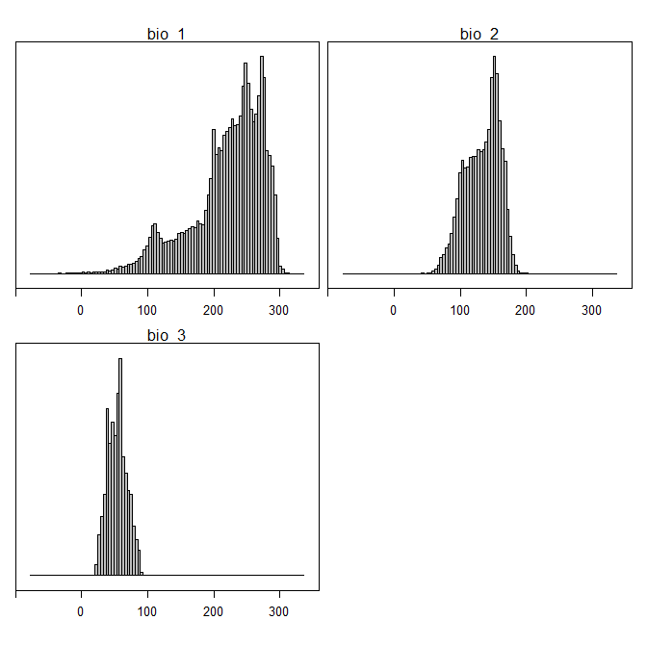
R and GIS
histogram(s)
Frequency Histograms
splom(s)
Scatterplots with hexagonal binnings
bwplot(s)
Box-and-Whisker and Violin Plots

Slide 36
R and GIS
Topic | Code | Description
Plot Raster maps | >plot(bio1) >plot(bio1, main=“title”, col=rainbow(5)) | Plot the map with default settings Change some attributes
 | >install.packages(“rasterVis”) >s=stack(bio1,bio2,bio3) >levelplot(s) | Produce a levelplot from stacks
 | >levelplot(bio1) >levelplot(bio1, contour=TRUE, FUN.margin=max) >levelplot(bio1, contour=TRUE, margin=FALSE, par.settings=BTCTheme) | Produce a levelplot with only one file Include contour lines and change the marginal function Change the colors
Create other plots | >splom(s) >histogram(s) >bwplot(s) | Create Scatterplot matrix with hexagonal binnings Create a histogram matrix Create box-whisker-violin plots

Slide 37
Task 7
Plot some of the maps you have generated with different colors and settings
Plot some additional Graphics such as histograms and boxplots and change the settings

Slide 38
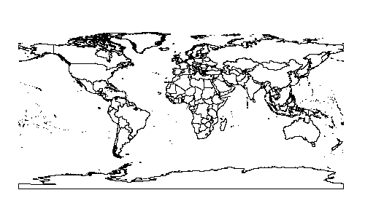
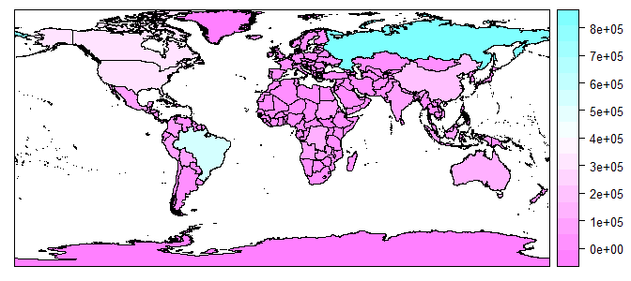
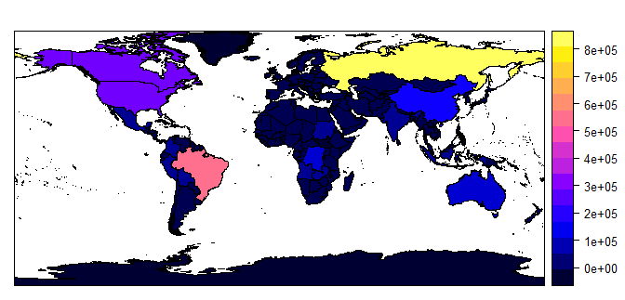
>plot(forest)
>spplot(forest, "Y_2010")
>spplot(forest,"Y_2010", col.regions=bpy.colors(30))

Slide 39
Topic | Code | Description
 | > install.packages("maptools") > library(maptools)
Vector data – import | >forest<-readShapePoly(readShapePoly("forest_extent/UNEP_EDE__forest_total_extent__1392130365") >forest <- readOGR(dsn = "forest_extent", layer="UNEP_EDE__forest_total_extent__1392130365") | Import shapefile with polygon data readShapeLines and readShapePoints imports other vector files but does not read Projection. Use readOGR instead, where dsn refers to the folder with the shp and layer refers to the shp file
Access attributes | > forest$Y_2010
Plot vector map | >plot(forest) >spplot(forest, "Y_2010") >spplot(forest,"Y_2010", cuts=c() col.regions=bpy.colors(5)) >spplot(forest,"Y_2010", col.regions=bpy.colors(30)) | Plots the shape without attributes Plot the shape with the attribute spplot as color. Change the color scheme by using a colour generating function. You can change the number of levels with the argument “at”
 | rainbow(n), heat.colors(n), terrain.colors(n), topo.colors(n) cm.colors(n) | Standard Colour schemes

Slide 40
Task 8
Do what you like!
Have fun with R and do not get frustrated.
Have a nice weekend.

